Slide 1

PLEASE CLICK TO START THE PRESENTATION

Slide 2

ETISALAT INFORMATION SERVICES
PRESENTATION ON HYPER LOCAL SEARCH ENGINE PROJECT
PRESENTED BY DEEPTHI KRISHNA, BUSINESS HEAD VERBANET TECHNOLOGIES LLC

Slide 3

INTRODUCTION

Slide 4






Engaging digital experience by leveraging emergent technologies
Project scope
Design & Develop and easy to maintain Hyper Local Search Engine (with companion mobile app) that is capable of delivering and adapting to large amounts of constantly changing information.
Site shall be integrated with CMS to manage & publish static content using an industry standard approval workflow.
User acquisition through innovative loyalty programs
Increase customer retention through personalized interactions
Convenience: technology convergence & Omni channel experience

Slide 5
PLATFORM STAKEHOLDERS

Slide 6

The Public
Etisalat
The Copywriters
PLATFORM STAKEHOLDERS
2
4
6
1
3
5
The Advertisers
The Editors/Publishers
The System Admin

Slide 7
FUNCTIONAL SPECIFICATION

Slide 8

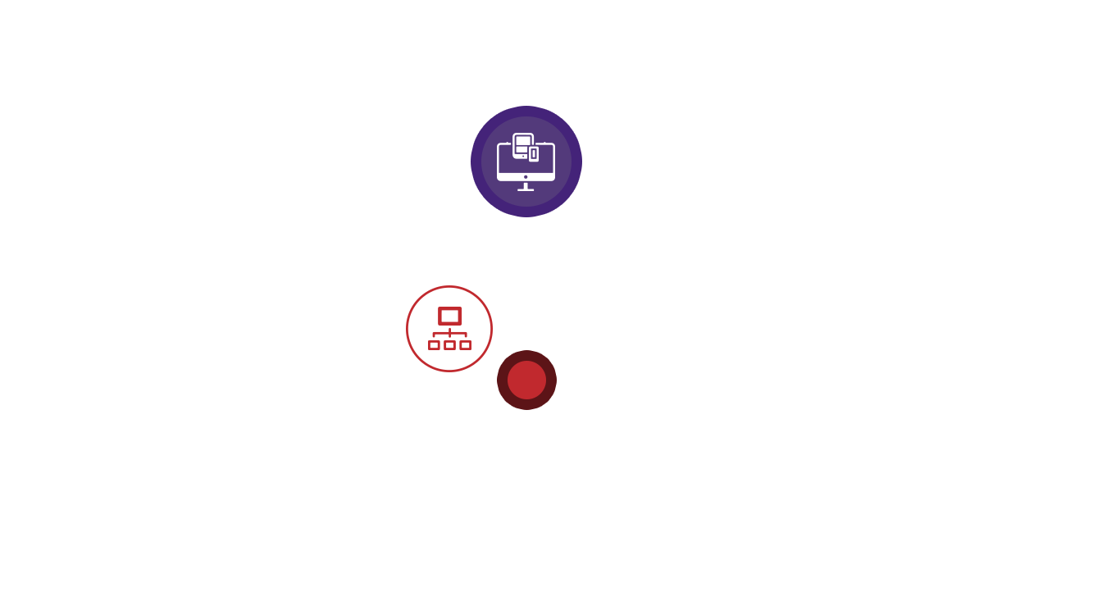
WEBSITE FUNCTIONAL REQUIREMENTS
Home page (Inspiration yellowpages.com, connect.ae)
1
English & Arabic Language
Time sensitive adverts & promotions
Featured company, Mobile app Download
Header Logo, language Selection, login, Signup
Footer (links managed by admin)
About Us, Contact, Advertise, Help, Privacy
Terms of use, Frequent Searches
Feedback, Site Map, Hamburger Menu
Newsletter signup, Dynamic image behind search bar
Social media links, Search Bar (location enable option + Map view results option)
Home page Section
2

Slide 9
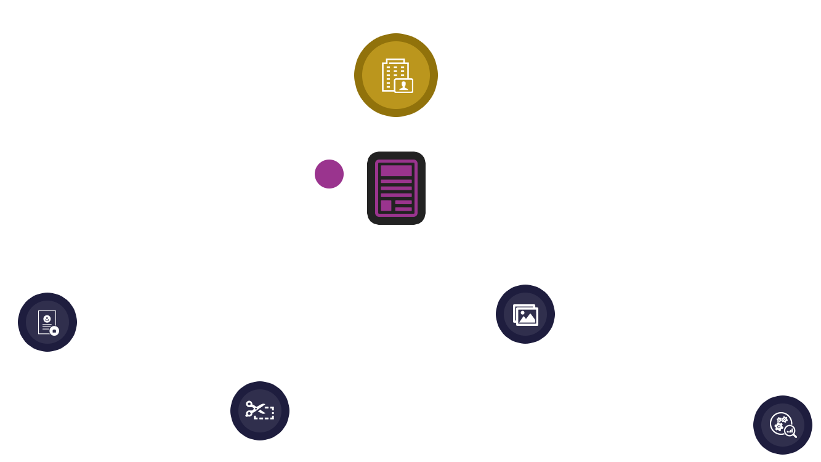
Dynamic sections based of membership type. Sections suppressed for non-privileged users
Detailed profile pages similar to Yellow Pages company directory
3
Company Profile
4
Page Details (Tabbed)
Gallery
Business Details
5
6
7
8
Coupons
Reviews

Slide 10
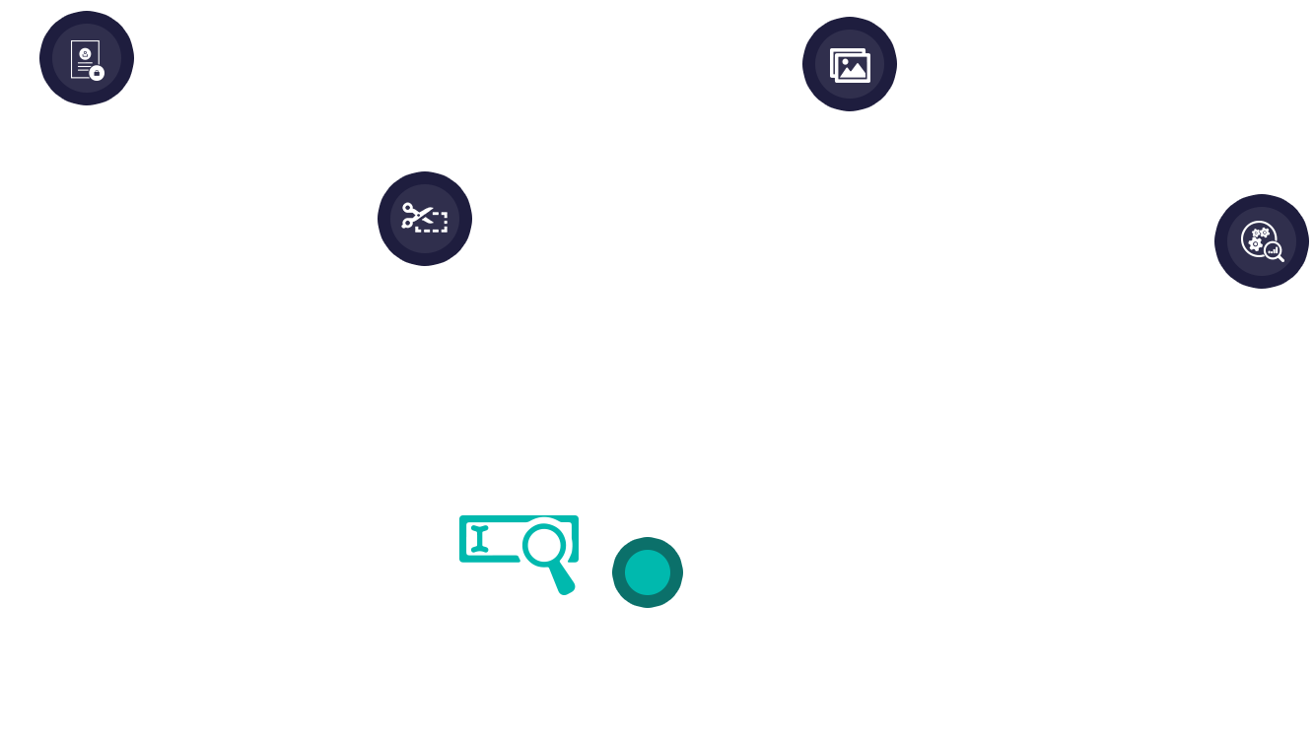
Business Details
Coupons
Gallery
Reviews
Description, logo, opening hours, deep links, video, social media links
Send email to company (mobile and web)
Forward company details via SMS (mobile)…
List Reviews
Post Reviews
Related searches
Advertisement section
Reviews from connect.ae
Reviews from aggregators
Search Bar
9

Slide 11
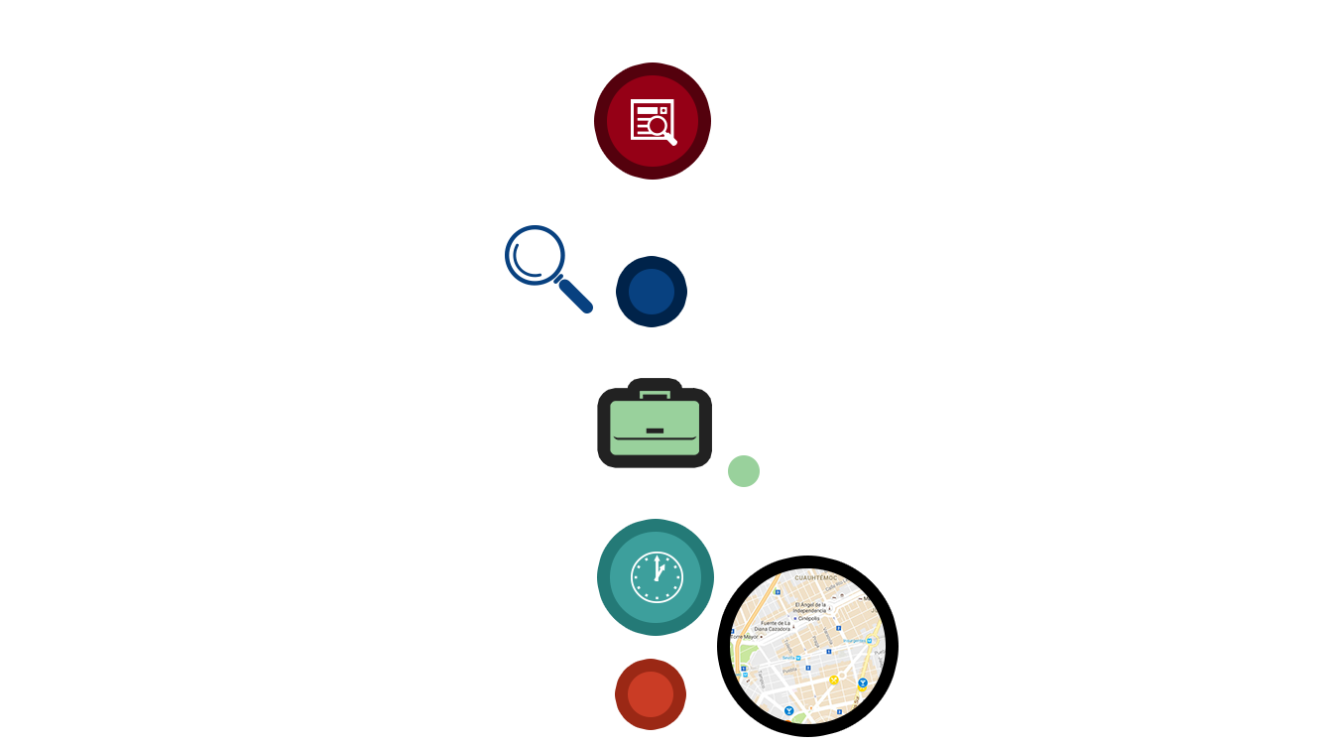
10
Search Bar Features
5 dynamic search results (ref: connect.ae)
Magnifying Glass: Directs to the search results page (results from internal source)
11
12
Briefcase: Directs to the company profile
Clock: use previous search result for the keyword in use
POI: Directs to map
For tablets and mobiles, results based on location
13

Slide 12

14
Search Results page
Total results returned
List of 20 results page
map with number tags (resizable)
Sort by relevance, distance popularity ( like connect.ae)
filter by order online, kid friendly etc. (similar to YP.com)
About Search results
Sponsored results
Map fixed while scrolling
Sponsored advertisements on right panel
Homepage header fixed while scrolling
Suggested keywords
Reset search filters and sorting to defaults

Slide 13
15
Search Results Details (Individual Listing)
Thumbnail image, Social media links
Phone, fax & address, Number on map
Hours of operation
Description
Rating (connect.ae & aggregator)
Website address and Menu, Order online (link), Order online (link)
Categories (list)
Clicking on map number resizes and zooms the map with selected number and surrounding listings

Slide 14
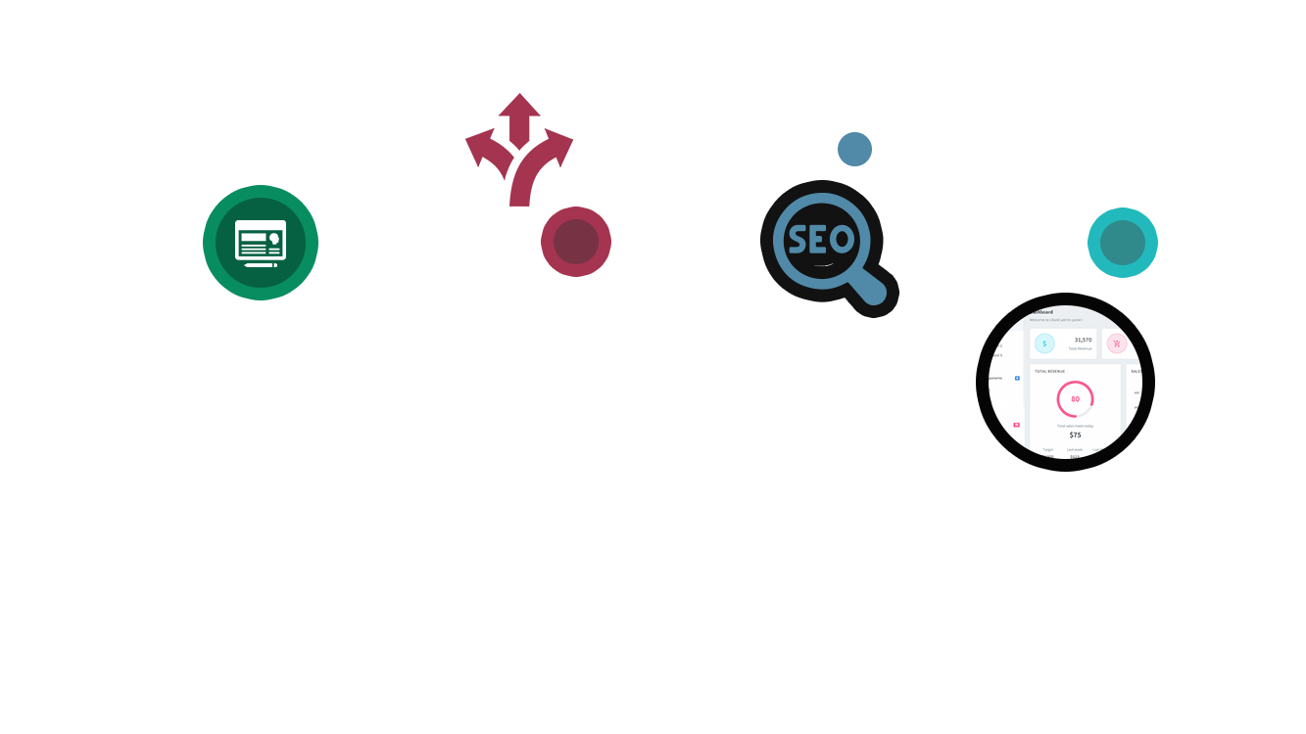
Screens for master data
Screen for Users, categories, adverts etc.
Advertisement Revenue management
API management
16
18
Admin Dashboard
17
19
Registrations
Directions to location
SEO Ready
User Registration
Advertisement registration
Register via social media
Print Directions
Route on map
Directions list
Map Coordinates
Breadcrumb
No follow tags
Schema tags
Human readable URLs
Static content for category pages
update met tags
Responsive design

Slide 15

CMS FUNCTIONAL REQUIREMENTS
1
Category Management
2
Content Management System
Advertisement Management
3

Slide 16
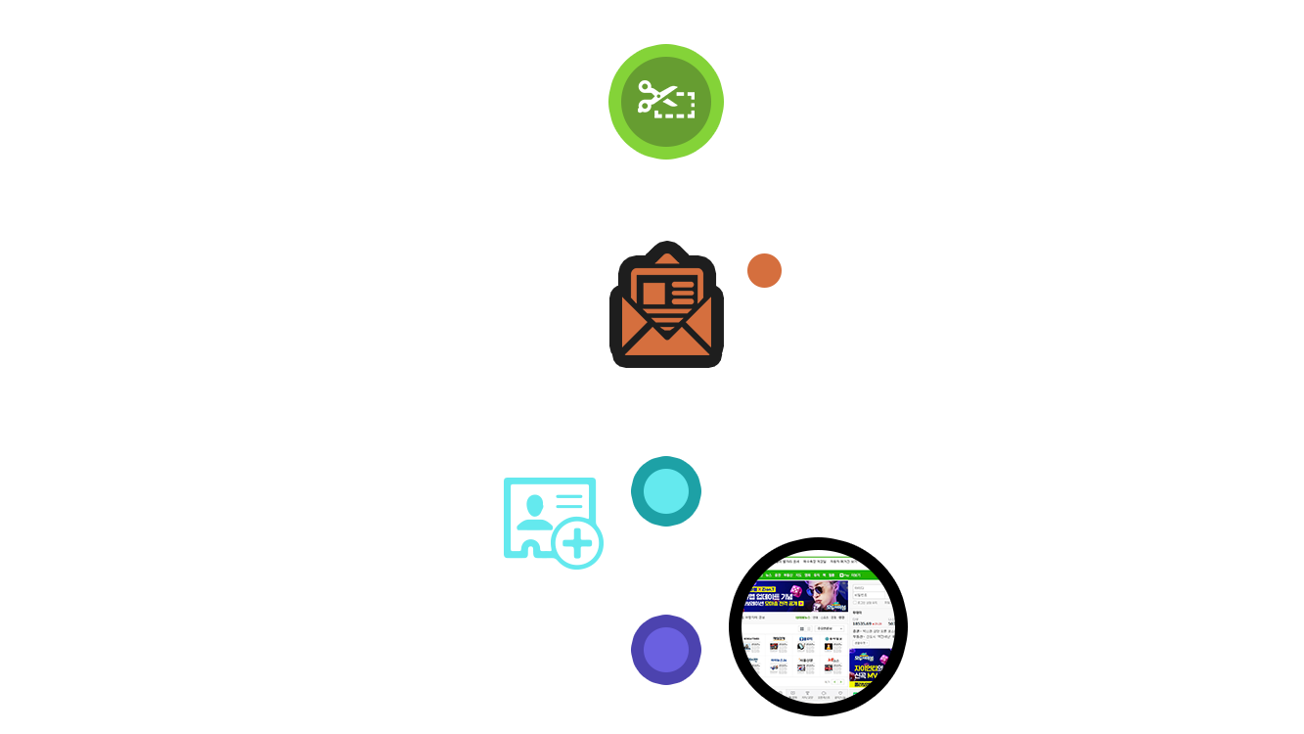
4
Coupon Management
Newsletter Management
5
Member Registrations
Template for Static Pages (Managed Content)
6
Manage Time Bound Adverts
7

Slide 17
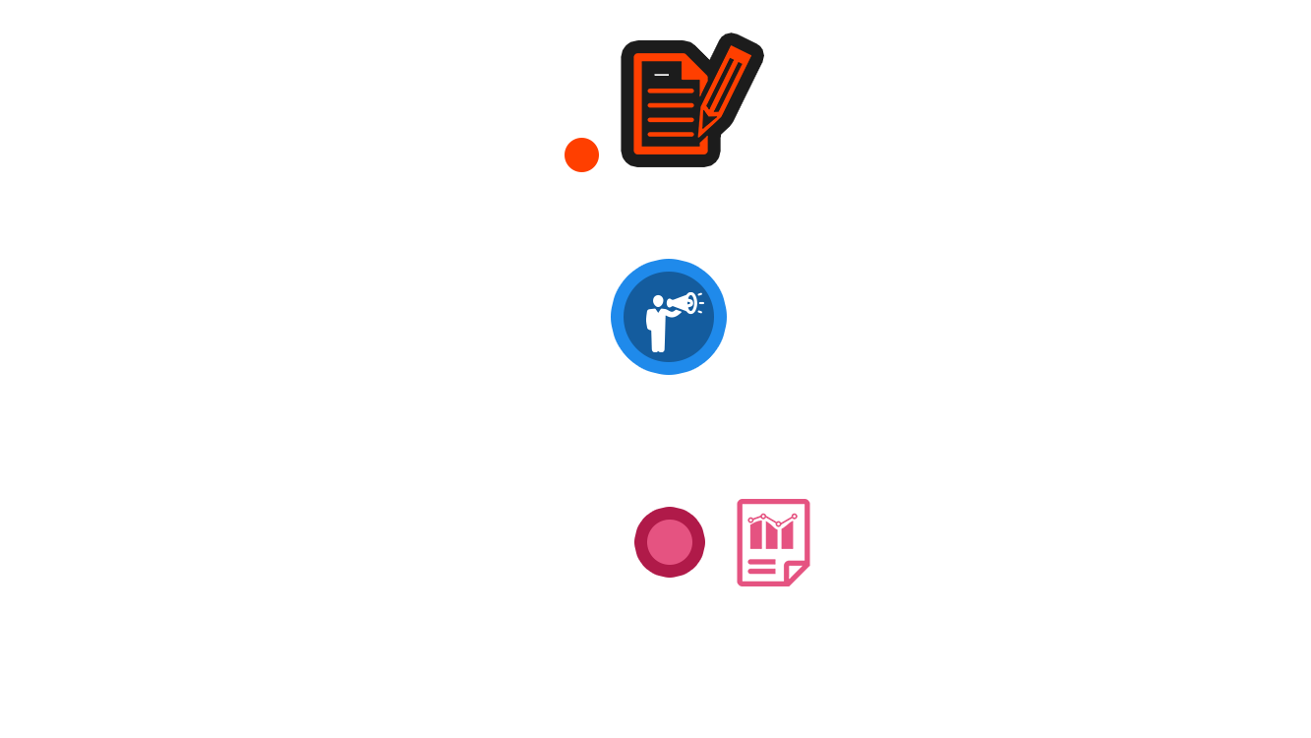
8
Content Manager Roles
9
Advertisement Management
Advertisement Revenue Reports for connect.ae & expenses for advertisers
10

Slide 18
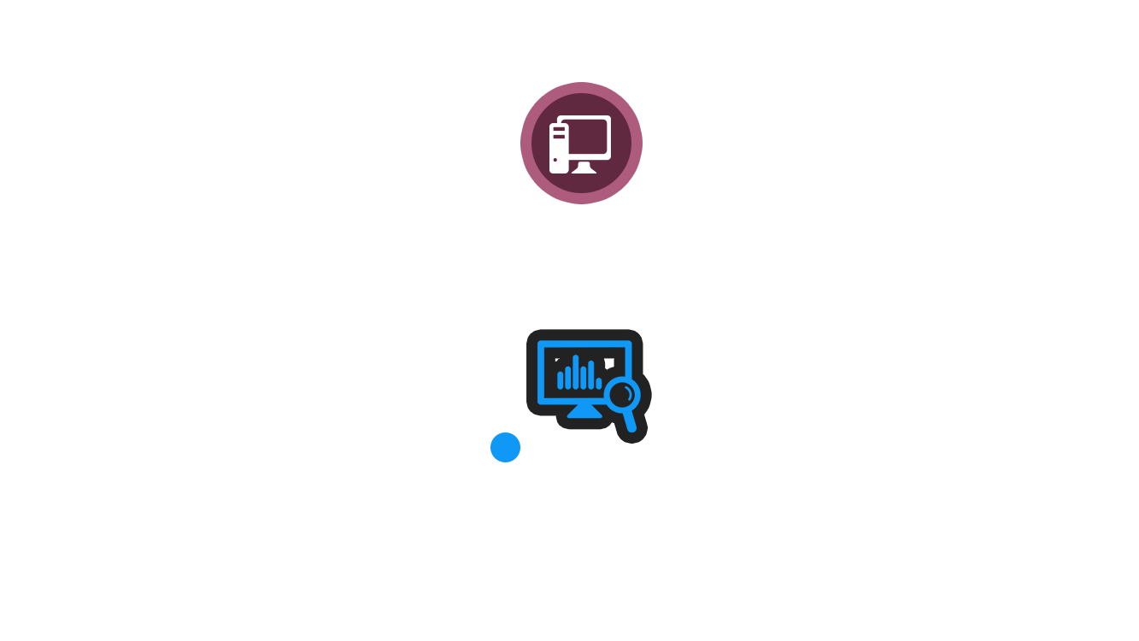
SYSTEM FEATURES
Authentication and Authorization
Permission based access levels
Bilingual website
Advanced workflow and approval process for content management
Content management framework
Auditing and logging
System Features
1
Word recognition using fuzzy logic
Word stemming
Synonym recognition
Geographic context analysis (to enable hyper local search)
Rule based search results
Parameterized search result limit
Search dropdown categorization
Web Based search results
Mobile based search results
Search results based on geo fencing
Randomization of search results for results with identical priorities
Semantic analysis of keywords
2

Slide 19

Advertisements
Time bound advertisements
Context sensitive advertisements based on key words
Integration with advertisements networks
3
Company
Product: logo
Product: homepage
Product email
Product: click to call
Product: company description
Permission product: Ranked search word limit
Permission product: deep link
Permission product: PDF
Mobile search logic order: local, comprehensive, paid adverts first,
Payment processing
5
4
API Calls
CRM Dataflow
Add customer from web to CRM
Scheduled job generates Excel sheet
Move the spreadsheets to landing pad via SFTP
Advert XML generated from the spread sheet and pumped to ActiveMQ

Slide 20
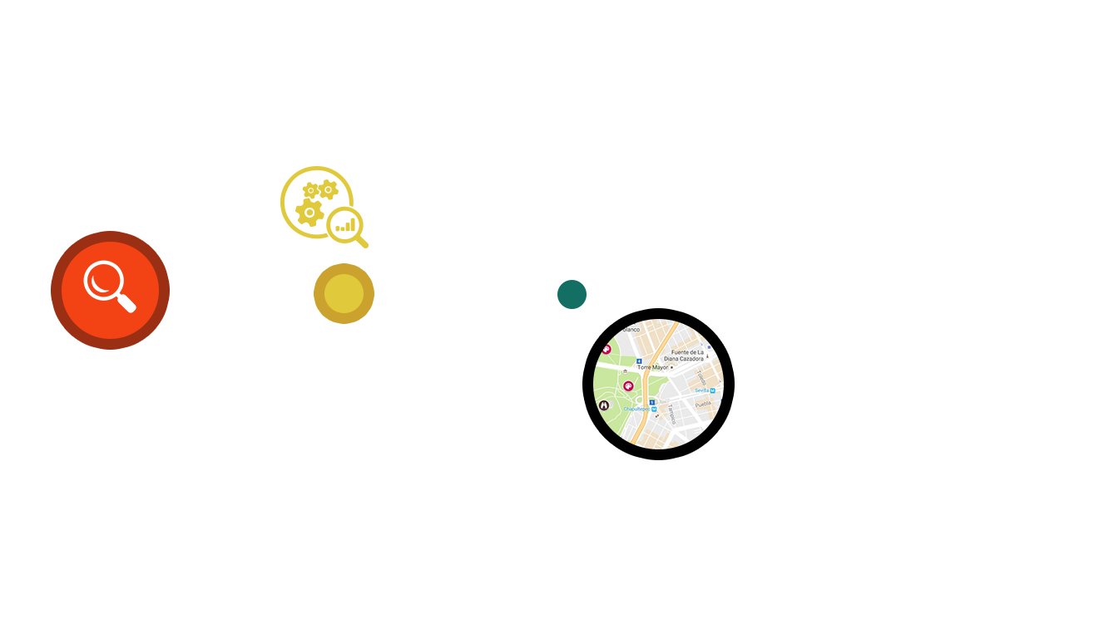
Search Integration with 3rd Party
Reviews Integration
8
7
6
Zomato
Trip Advisor
Round menu
Connect.ae
Map Integration
Zomato
Booking
Round Menu
Zoom in and zoom out
Driving directions

Slide 21
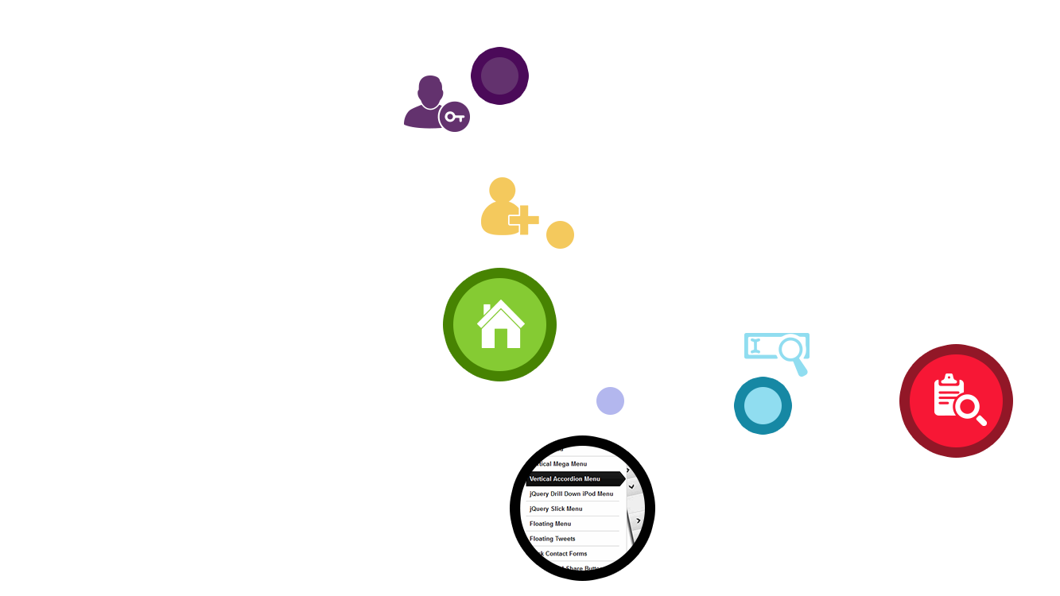
MOBILE FEATURES
1
Login Page
2
Design and development(API integration, Validation)
Register with social media (Face book and Gmail)
Sign Up
5
Home Page
3
4
Search Bar
Search Results

Slide 22
MOBILE FEATURES

Slide 23
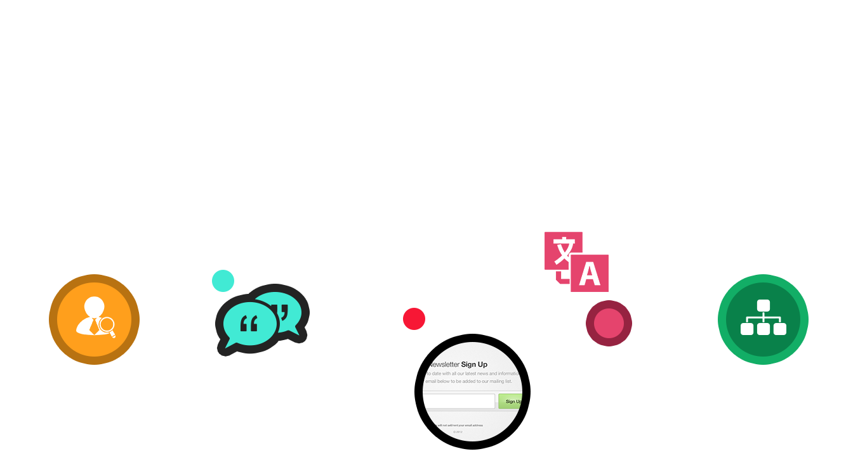
Business Details
Coupons
Gallery
Reviews
Advertisement Section
7
Feedback
Newsletter Signup
9
10
Language
Frequent Searches
8
11

Slide 24

Video
Send email to company
Forward company details via SMS
Save company details as vCard
Click to call
Post in social media (Face Book)
List of features (Child safe, cuisine, attire etc.)
Reviews count on top & aggregators count
Map view results
Reviews from aggregators
Post Reviews
Show Directions
Route on map
Business Details Design and API Integration
13
Deep Links
12

Slide 25
DESIGN CONCEPT

Slide 26
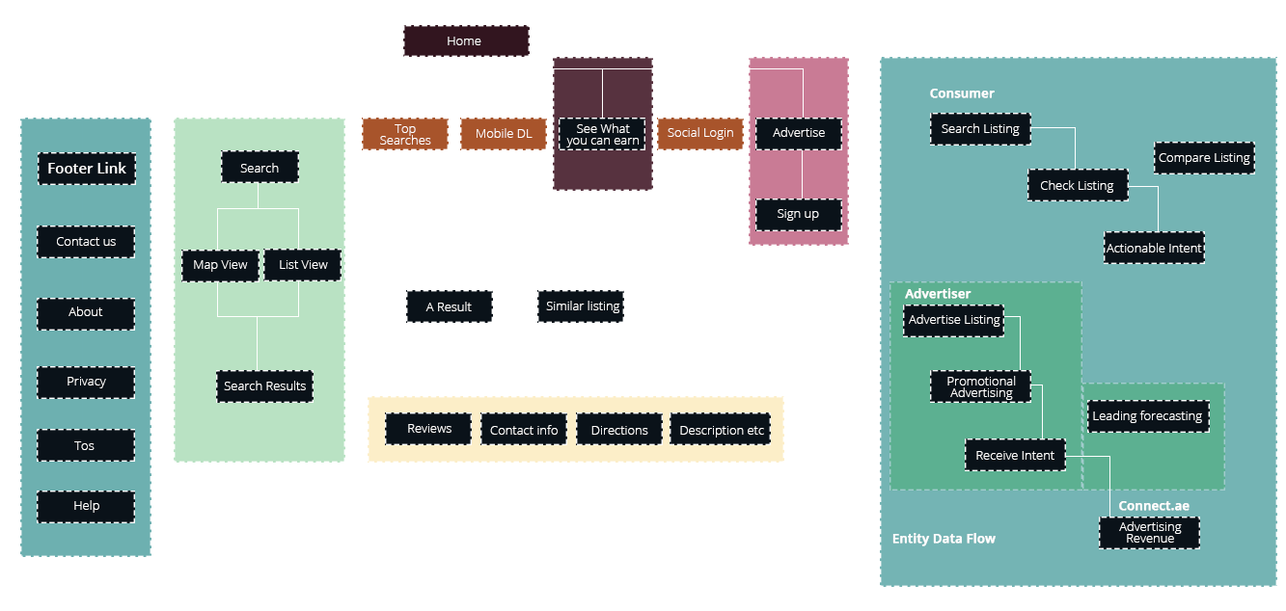

Slide 27
USER CHARACTERISTICS

Slide 28
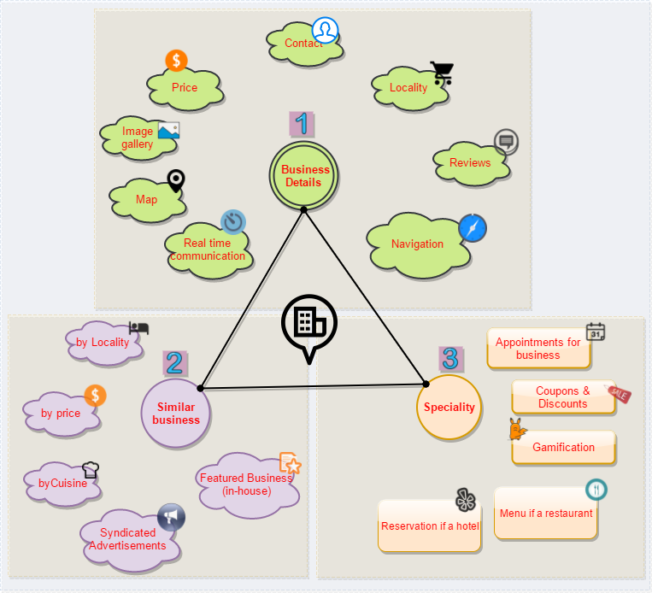
CUSTOMERS

Slide 29
Brand Ads
Keyword Ads
Affiliate Marketing
Unicast Ads
Coupons redeemed
Contextual Ads
Pay per impression
Increase Revenue
Driving Directions
Search by name
ADVERTISERS
Interactions
Pay per view
Related searches
Social media referrals
Time Bound Ads
Value Redeemed
Redirects
Visit to details page
Reservations

Slide 30
Faster results
Convenience
Discount & Coupon
Aggregated reviews
Online reevations
Recommendations based on past search
Improved Interactions
Other revenue streams
Brand Awareness
Increased visitors
CONNECT.AE
Context sensitive results
Merchant Models
Advanced mapping & directions
Bargains
Network effect
Algorithmic Search
Increased Revenue
Localized advertisements
Agency model

Slide 31
SYSTEM ARCHITECTURE

Slide 32
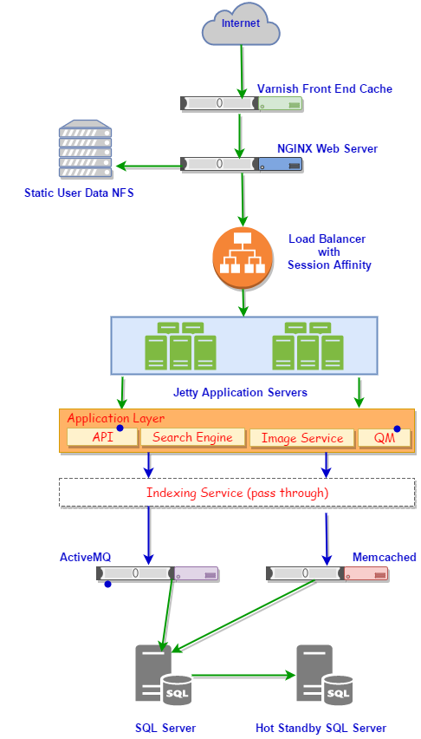

Slide 33
KEYWORD SEARCH

Slide 34
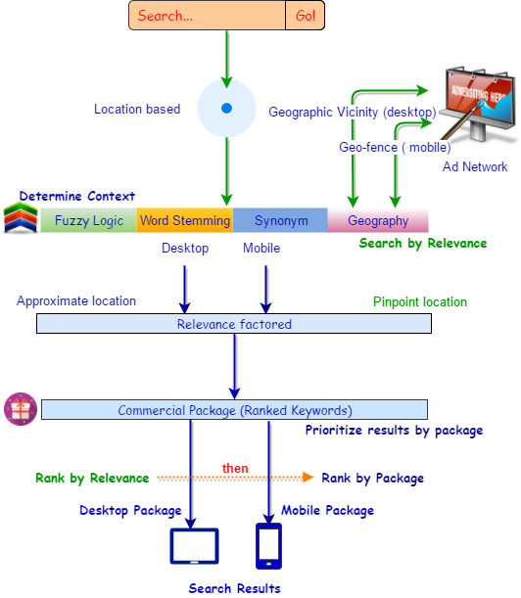

Slide 35
SYSTEM WORKFLOW

Slide 36
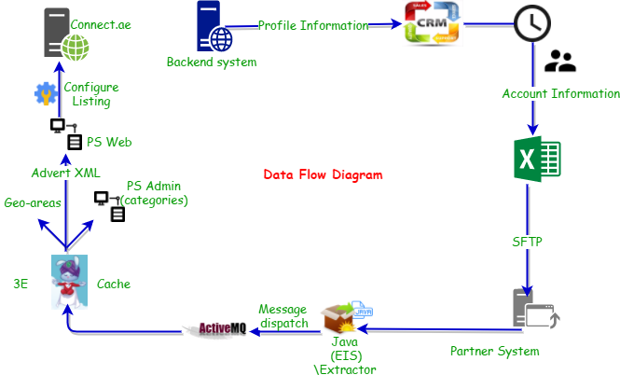

Slide 37
APPLICATION ARCHITECTURE

Slide 38
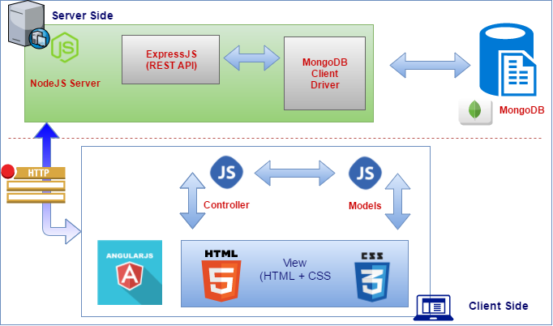

Slide 39
DEVELOPMENT TOOLS

Slide 40
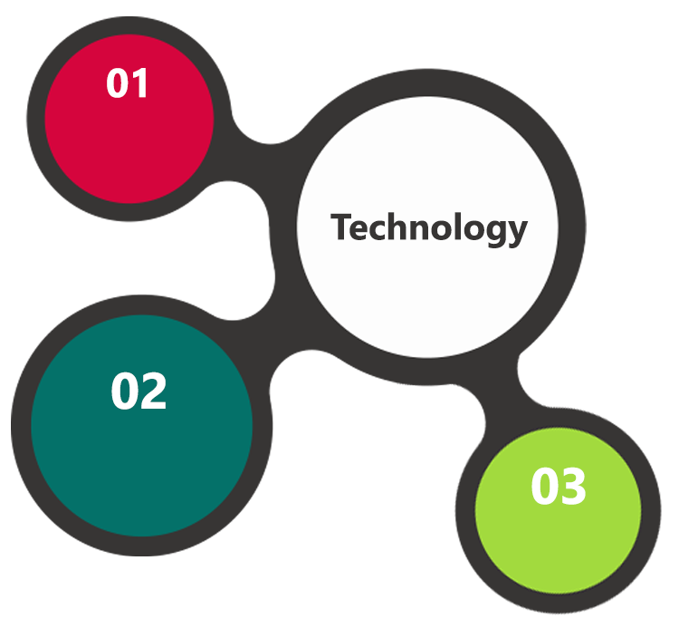
Development Tools
MVC, Angular
NodeJS, Express JS, MongoDB
HTML / CSS 3
Ajax, JavaScript, JQuery
Minimum Web Hosting
OctaCore CPU
RAM: 32 GB
MongoDB Enterprise Advanced
Disk Space: 1 TB
Monthly Bandwidth: 20 TB
Web site Server Software – Apache
Browser Compatibility
Chrome version: 56
Firefox version: 51
Edge version: 39
Safari version 10.1
Angular
NodeJS, Express, MongoDB
HTML / CSS3/ Jquery

Slide 41

[
[
Q A
nd

Slide 42

Thank You
www.verbat.com
© 1999-2017. All Rights Reserved. Verbanet Technologies LLC.

